Slide 1
Reminders
Read the assigned primary research article and take notes in preparation for class on Friday (instructions and guidelines to reading primary literature on canvas)
Review the term project instructions in the “Term Projects #1 & 2” module. You should begin working on the written component of this project (due 2/4)
Quiz #1 IN CLASS on Monday

Slide 2
Quiz #1 Format:
Quiz will be handed out at 2pm and collected at 2:50. No extra time can be given for late arrivals
Primarily short answer format questions
Can reflect material from text (chapters 3 & 4), lectures, primary literature readings and in-class discussions
Study pointers:
Review end-if chapter ‘key concepts’
Review at-home mini-quiz answers. Be sure you understand any questions you got wrong
Review primary literature worksheet notes
Be comfortable discussing end of chapter ‘thought questions’

Slide 3
Lecture 5: Cellular Oncogenes
OBJECTIVES
Be able to provide examples of the similarities and differences between viral oncogenes and cellular oncogenes
Be able to explain an experimental approach testing the transformative potential of an agent or gene
Begin to appreciate the diverse pathways disrupted in cellular transformation and tumor formation

Slide 4
Experimental techniques in cancer biology research
Goals
Approaches
Know what genomic changes are present
Know what RNA changes are present
Karyotype analysis (large scale DNA changes)
Microarray (DNA or RNA copy number)
Southern blot (DNA copy number
DNA/RNA sequencing (copy number, translocations, sequence changes
What are the benefits or limitations of each approach?

Slide 5
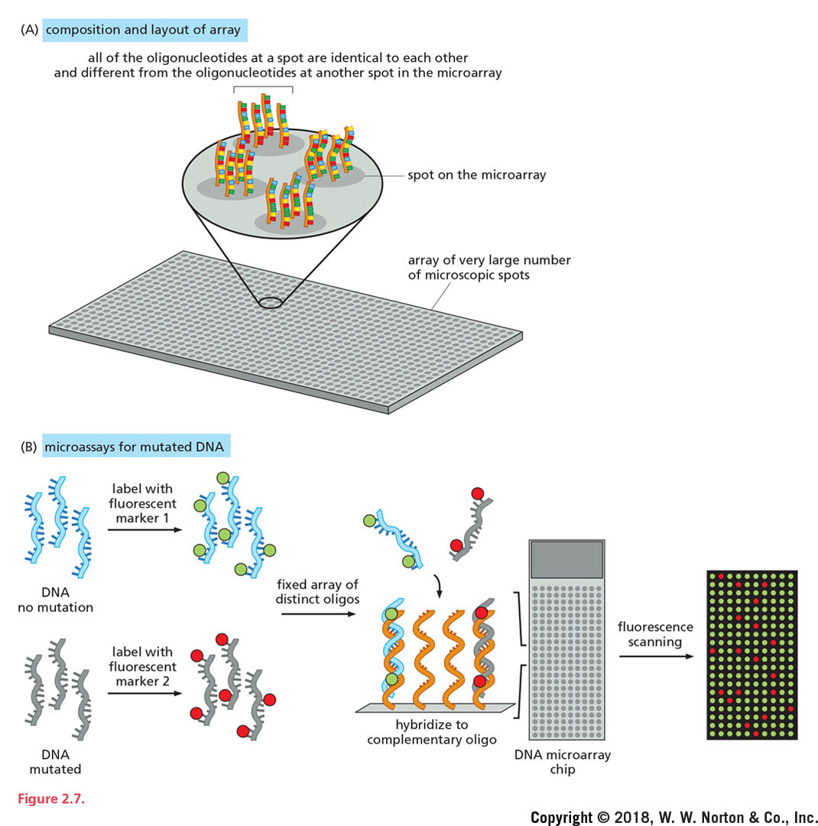
How are amplifications identified?
Benefits:
Robust comparative measure of DNA or RNA levels
High throughput (look at lots of genes at once)
Easy to read/interpret (color-based assay)
ie how can we know which oncogenes are amplified or overexpressed in cancer?
Microarray analysis
Green = less of that DNA/RNA in the tumor sample
Red = more of that DNA/RNA in the tumor sample
Yellow = similar amounts of that DNA/RNA in both samples
DNA from healthy cells
DNA from tumor cells

Slide 6
How are amplifications identified?
Limitations:
No info about mutations or protein function
Can only assess the genes that are part of the array (ie need to already have candidate genes in mind)
ie how can we know which oncogenes are amplified or overexpressed in cancer?
Microarray analysis
DNA from healthy cells
DNA from tumor cells

Slide 7
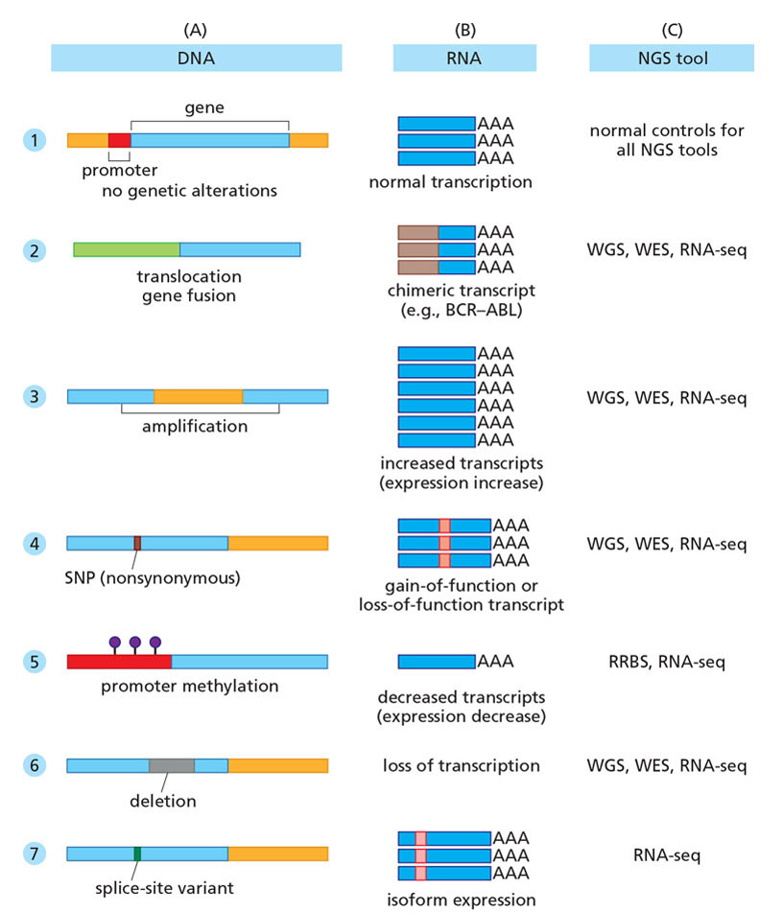
How are amplifications identified?
RNA (or DNA) sequencing
Whole genome sequencing
Whole exome sequencing
RNA sequencing
Benefits:
Comprehensively identifies of mutations and DNA/RNA levels
Limitations:
Expensive and time consuming analysis
Interpretation is limited by biological understanding (not all mutations impact protein function)

Slide 8
Experimental techniques in cancer biology research
Goals
Approaches
Know what genomic changes are present
Know what RNA changes are present
Know if protein levels or function are altered
Western blot (protein expression)
Enzymatic/functional assays
Requires knowledge of what protein you’re interested in and what pathway it functions in

Slide 9
Oncoviruses
Tomasetti et al., Science, 2017
Estimated that ~66% of all driver mutations arise from normal mutations rates
29% arise from environmental factors
5% are hereditary
Exposure to chemicals
UV light
Some types of viral infections

Slide 10
Oncoviruses in cancer
Initially thought to be THE cause of cancer
→ we now know viruses contribute to only a subset of cancers
Involvement of viruses (and other infectious agents) in cancer continue to be a challenge worldwide
→ Prevent and treat infection to limit cancer

Slide 11

Viral contributions to cancer
Viruses are infectious agents that can only replicate within cells of other living organisms
Human are affected by a variety of viruses
Common cold
Influenza
AIDS
Cancer
Viral infection is responsible for 15-20% of cancers

Slide 12
Viral impact on the human genome
In some ways viral contributions to cancer are similar to random mutagenesis
There are 3 main ways that viruses contribute to cancer:
Disrupt normal gene sequence with insertions (similar to mutagenesis)
Hijack a gene and promote its function (similar effect as oncogene translocations/fusions)
Express an inhibitor of gene function (a viral oncogene)

Slide 13
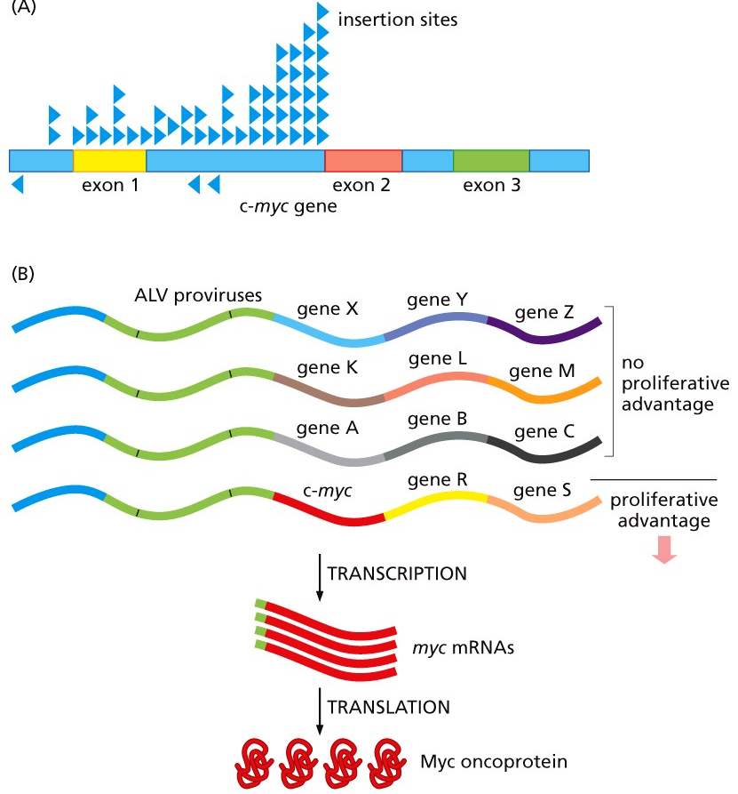
Viruses integrate into the genome
Integration: virus integrates into the host cell’s genome and causes activation or inactivation of oncogenes or tumor suppressors
Integration is random (similar to random mutagenesis)

Slide 14
Viruses integrate into the genome
Integration: virus integrates into the host cell’s genome and causes activation or inactivation of oncogenes or tumor suppressors
Integration is random (similar to random mutagenesis)
position of the integration can disrupt nearby genes
changes in the regulation of a proto-oncogene or tumor suppressor can be tumorigenic

Slide 15
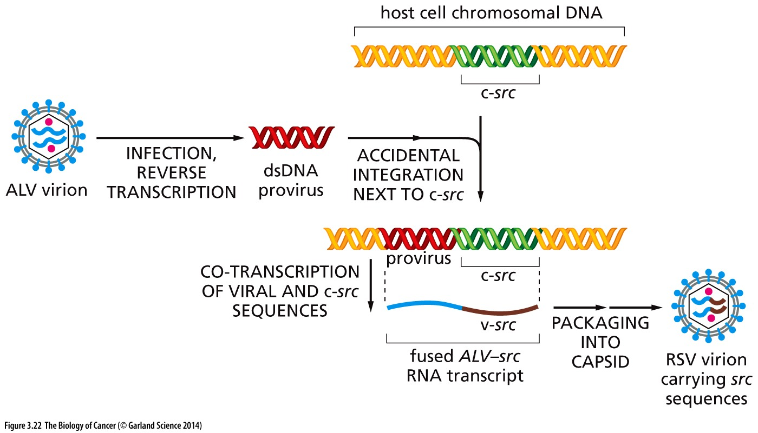
Viruses amplify oncogenes
Increase oncogene copy number: ancient RNA virus integrated into the host cell’s genome and ‘captured’ a host proto-oncogene
Captured gene becomes part of the viral genome
Viral infection leads to high expression of the oncogene and more rapid tumorigenesis

Slide 16
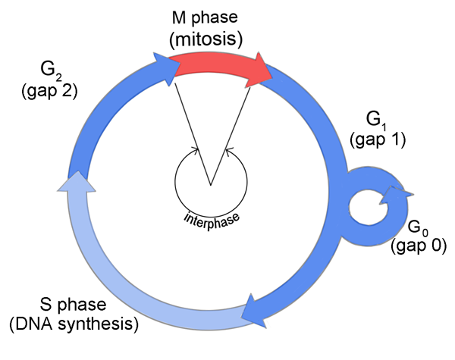
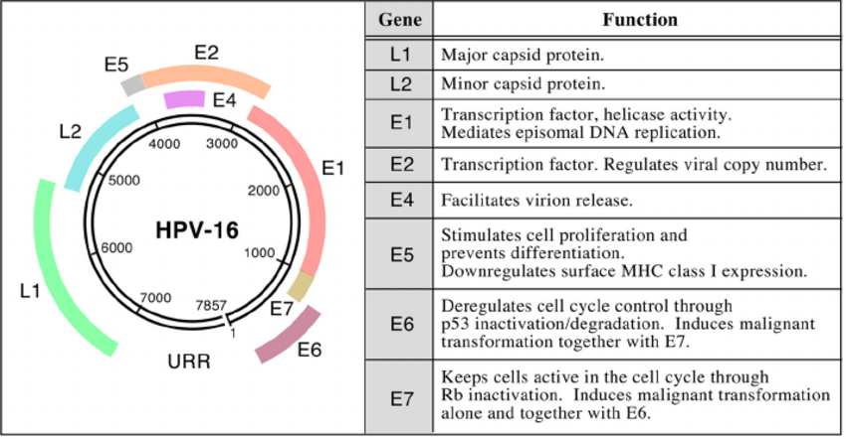
Viral proteins interfere with checkpoints
Expression of viral oncogenes that corrupt cellular pathways
Bind to and interfere with tumor suppressor function (p53, pRB: regulators of G1/S transition)
Responsible for ~80% of viral-induced cancers
HPV
HVC/HVC

Slide 17
Tumorigenesis is linked to viral integration
Viral genome is initially episomal
Hitches a rid on chromosomes with a linker protein
Viral particles are made, packaged and released to infect adjacent cells
Persistent infection: allows for transmission without re-infection
Still low risk for cell transformation
Human DNA Viral DNA

Slide 18
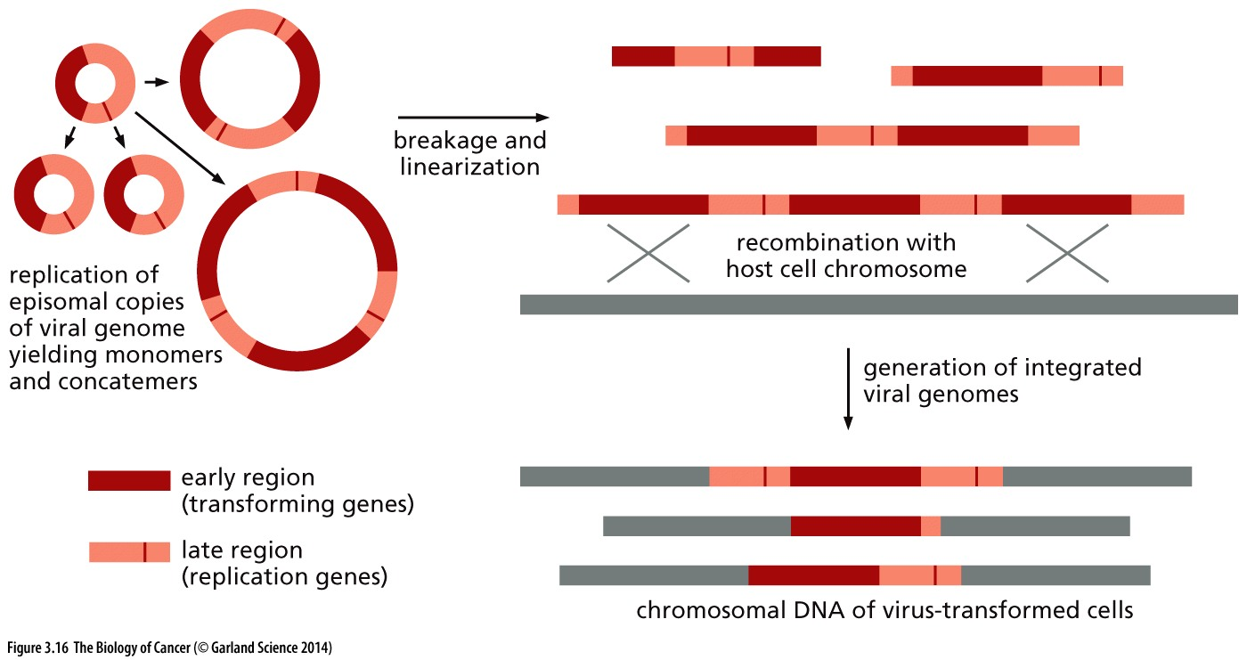
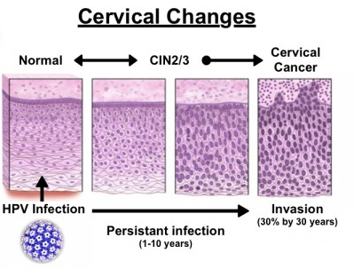
Tumorigenesis is linked to viral integration
Integration via HR
integrated viral DNA gets replicated and segregated with the host genome
Frees viral oncogene from transcriptional repression
Allows high expression on viral oncogenes
Cellular transformation is enabled
Integration is required for tumorigenesis
What therapeutic approaches does this suggest might be appropriate?

Slide 19
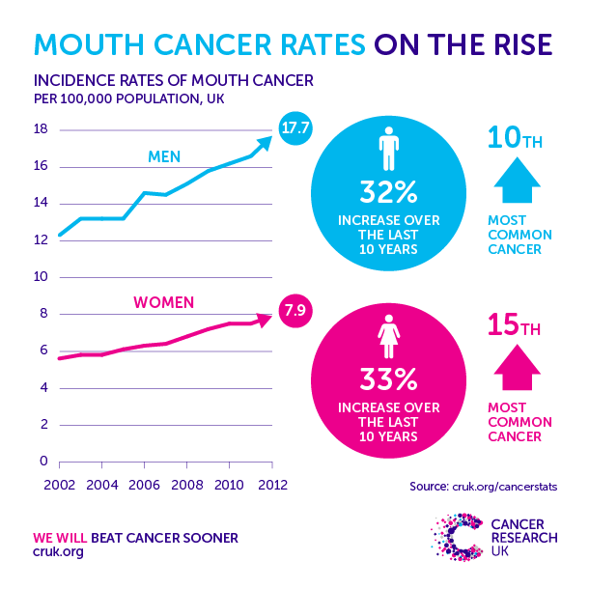
Vaccines as a cancer preventative
Vaccines that reduce long-term HPV infection have the potential to prevent cervical cancer (and other cancers!)
HPV is also responsible for ~20% of oropharyngeal cancers
Cancer genes are conserved in all cell types
Cancers of the mouth and throat continue to rise, even as tobacco-induced tumorigenesis in these tissues decline

Slide 20
Identifying cancer-promoting agents
How can we identify genes (or infectious agents, or chemicals) that promote cellular transformation?

Slide 21
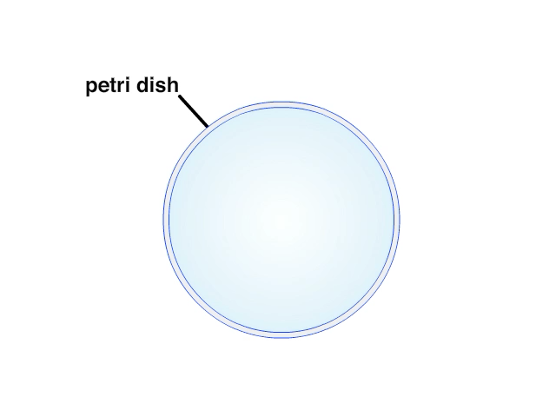
Growth changes in transformed cells
Remain proliferative when normal cells do not
When nutrients are lacking
When external growth signaling is lacking
When cells are confluent
Overgrowth becomes apparent in culture conditions
Can grow independent of adherence

Slide 22
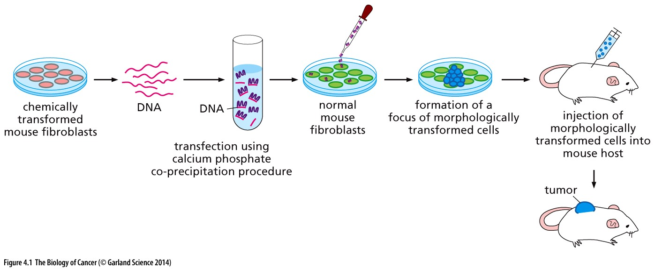
Identifying endogenous cancer genes
If nonviral oncogenes exist, DNA from a transformed cell should be able to promote transformation in a normal cell
Think/Pair/Share: is this transforming ability unique to oncogenes? Or will mutant tumor suppressors similarly be able to transform normal cells? Why or why not?
DNA from non-transformed cells did not induce transformation when transfected into normal fibroblasts

Slide 23
Cancer Gene Function
Cancer gene cards indicate 3 broad classes of genes:
Cell fate, cell survival & genome maintenance
a cell surviving and proliferating when it otherwise wouldn’t might form a benign growth, but is that sufficient to form a malignant cancer?
What else needs to happen?
what pathways need to be corrupted?

Slide 24
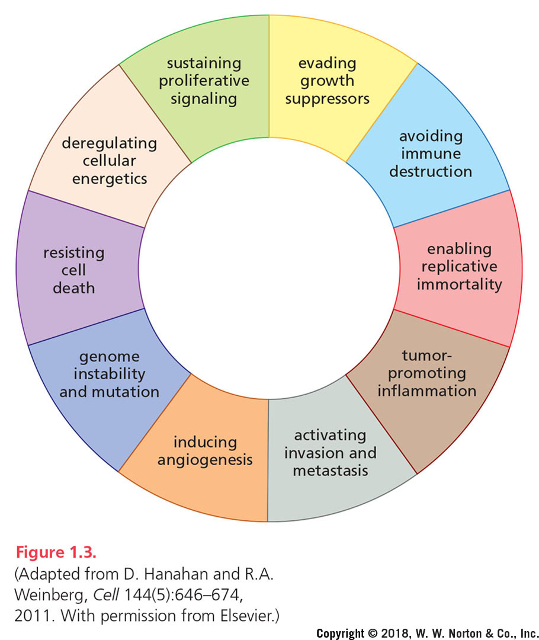
Chapters 3 to 5:
Activation of oncogenes
Chapter 7:
Loss of tumor suppressors
The capacity for unregulated proliferation is a key (and often early) feature of cancer cell transformation
But other changes are also common across most/all cancers
Hallmarks of cancer
Chapter 12:
Disruption DNA damage repair pathways
Notes:
Figure 1.3. The hallmarks of cancer. The figure provides a summary of the core attributes and capabilities manifested by cancers.

Slide 25
Chapters 3 to 5:
Activation of oncogenes
Chapter 7:
Loss of tumor suppressors
Chapter 2
Chapter 15
These hallmarks are features common in cancer
Cancer genes have roles in cellular pathways that influence one or more of these hallmarks
Chapters 7&9
Chapter 10
Hallmarks of cancer
Chapter 15
Chapter 12:
Disruption DNA damage repair pathways
Chapter 13
Chapter 14
Notes:
Figure 1.3. The hallmarks of cancer. The figure provides a summary of the core attributes and capabilities manifested by cancers.

Slide 26
Chapters 3 to 5
Chapter 7
Chapter 2
Chapter 15
Chapters 7&9
Chapter 10
Hallmarks of cancer
Chapter 12
Chapter 15
Chapter 13
Chapter 14
Notes:
Figure 1.3. The hallmarks of cancer. The figure provides a summary of the core attributes and capabilities manifested by cancers.

Slide 27
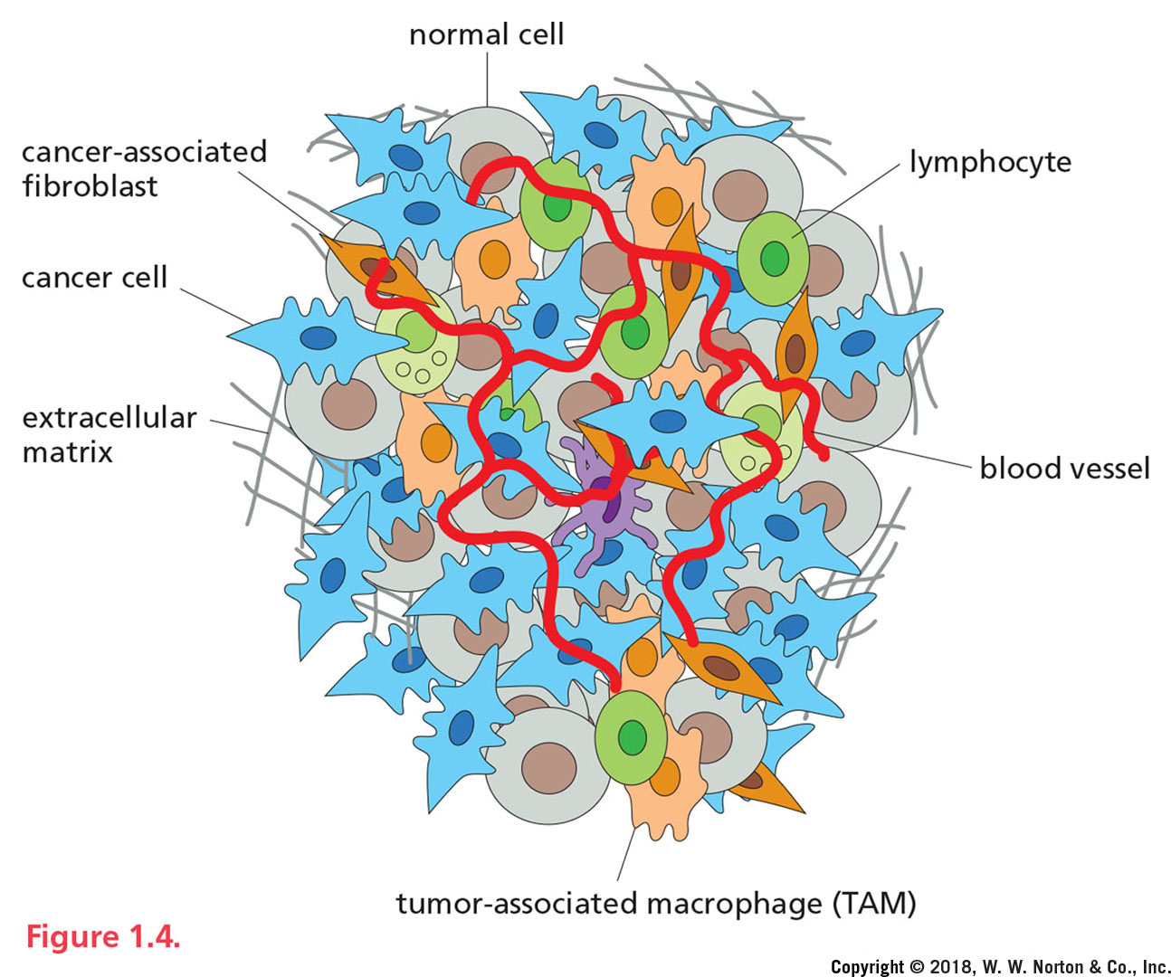
Tumors interact with their environment
The tumor microenvironment:
is made of more than just cancer cells
Poses challenges to the tumor that must be overcome
Represents non-cancer cell targets of cancer therapeutics

Slide 28
Cancer Therapies
Surgical resection
Solid primary tumors
conservative- radical:
Lumpectomy… removal of the tissue/organ/limb
‘rim’ of normal tissue (ie clean margins)
Nearby lymph nodes
Secondary tumors (metastases)
Not all tumors can be resected
Radiation therapy
Induces lethal levels of mutations
Some tissues are more responsive/sensitive then others
Can be palliative: to destroy metastases and improve life quality when cancer is incurable
May promote secondary secondary malignancies

Slide 29
Cancer Therapies – continued-
Medical cancer therapies
Cytotoxic chemotherapies
Kill rapidly dividing cancer cells
Kills rapidly dividing non-cancer cells
Personalized medicine
Identify and target cancer hallmarks or genomic changes in a specific cancer/type of cancer
Should be cancer-cell specific
Genomic changes must be identified
Cellular function must be understood
Identified target must be ‘drug-able’
Drug must not otherwise harm the patient/healthy patients

